Slide 1
Ch. 2: Psychological Research
Haddam-Killingworth High School
Fall 2016

Slide 2
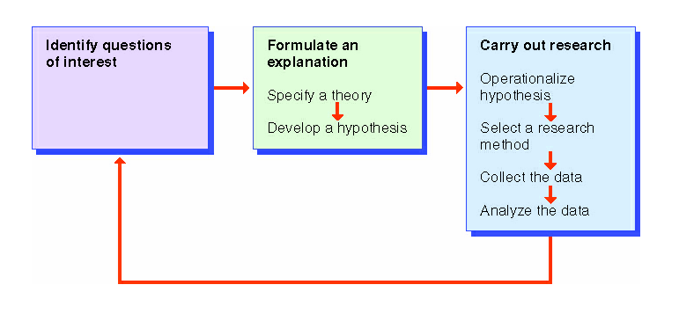
The Scientific Method
A system used to acquire knowledge and understanding about behavior and other related phenomena.
What are some areas of your life where you use the scientific method already?

Slide 3
Studies and experiments
https://www.youtube.com/watch?v=tkpUyB2xgTM
Doll test
https://www.youtube.com/watch?v=3imjiyLpBaU

Slide 4
Theories & Hypotheses
Theories
Broad explanations and predictions concerning phenomena of interest.
Hypotheses
A prediction stated in a way that allows it to be tested.
Generate a theory and a corresponding hypothesis to illustrate that you understand the two concepts.
Notes:
Theory: People are happier when they experience less traffic.
Hypothesis: People in Haddam and Killingworth who drive in non-rush hour conditions are happier as reported by surveys administered by mail to each resident of the two towns.

Slide 5
Testability
For a psychology experiment to be successful, a hypothesis must be operationalized into something that is testable.
On the Asking “Testable” Questions activity, please operationalize each of the questions by making them precise, objective, and verifiable.

Slide 6
Types of Psychological Research
Type | Definition | Pros | Cons
Archival Research | Existing data (such as census documents, college records, or newspaper clippings) are examined to test a hypothesis. | Inexpensive not time sensitive many options | Might not be in the right form Data could be incomplete or falsified
Naturalistic Observation | The investigator observes some naturally occurring behavior and does not make a change in the situation. | Get to see actual, natural habitat | Cannot control any of the factors of interest Could take a long time to find data If people know they are being watched, they act differently
Survey Research | A sample of people chosen to represent some larger group of interest (population) are asked a series of questions about their behavior, thoughts, or attitudes. | Can infer about greater populations based on small data sets Straightforward | People give inaccurate answers because of memory or choice Give the answer they think is wanted of them Sample may not represent greater population
The Case Study | An in-depth, intensive investigation of an individual or small group of people. | Can use insights from case studies to apply to bigger situations | Could misinterpret data and make improper assumptions about case significance

Slide 7
Correlational Research
Relationship between two variables is examined to determine if they are correlated
Correlation coefficient: between -1.0 and 1.0
Positive correlation: ↑↑ or ↓↓ = 1.0
Negative correlation: ↑↓ or ↓↑ =-1.0
No relationship = 0
Notes:
Positive correlation: the more studying you do, the higher grades you’ll get
Negative correlation: the more sleep you get, the less stress you’ll have

Slide 8
Correlation
≠
Causation
What does this mean? Can you think of examples that justify this statement?

Slide 9
Which is more likely: Correlation or Causation?
1.) | Exercise reduces risk of obesity | Causation
2.) | Teenage sex leads to bad moods in later life | Correlation
3.) | Private college students perform better, earn higher GPAs | Correlation
4.) | Straight A’s in high school leads to better health later in life | Correlation
5.) | Lots of candy could lead to violence | Correlation
6.) | Daily school recess improves classroom behavior | Causation
7.) | Board-certified teachers boost student scores | Causation
8.) | Bullying harms kids’ mental health | Causation
9.) | TV raises blood pressure in obese kids | Correlation
10.) | Student studying raises academic performance | Causation

Slide 10
Experimental Issues
Example: Testing various drugs for treatment of the common cold
Treatment group
Manipulated/treated with the drugs
Control group
No treatment
Independent Variable (X)
What you manipulate: type of drug
Dependent Variable (Y)
Dependent on the independent variable: results

Slide 11
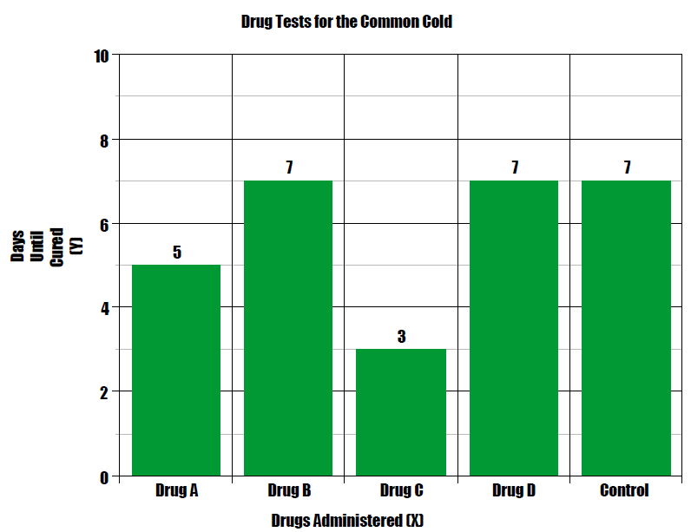

Slide 12
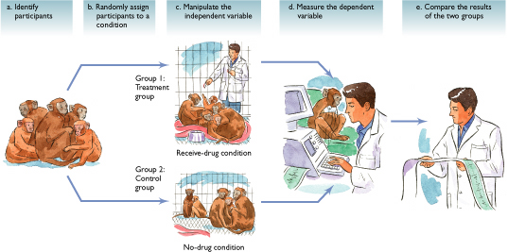
Key Experimental Elements

Slide 13
(More) Types of Psychological Research
Type | Definition | Pros | Cons
Descriptive and Correlational Research | Researcher observes a previously existing situation but does not make a change in the situation | Offers insights into relationships between variables | Cannot determine causality
Subtypes: Archival, Naturalistic, Survey, and Case Study
Experimental Research | Investigator produces a change in one variable to observe the effects of that change on other variables | Experiments offer the only way to determine cause-and-effect relationships | To be valid, experiments require random assignment of participants to conditions, well-conceptualized independent and dependent variables, and other careful controls
Notes:
Write this one in their notebooks; work on it more quickly than the previous “Types of Psych Research” chart.

Slide 14
Research: Quick Check Activity
The following activity has been designed to gauge your ability to assess the approach of various psychological studies.
For each scenario, pick one of the options listed. The options may be used more than once.

Slide 15
Ethics & Challenges of Research
Requirements of research
Protection from physical and mental harm.
Right to privacy regarding behavior.
Participation is completely voluntary.
Must inform participants about the nature of procedures prior to their participation.
If deception / human use = review by independent panel.
Research on animals: pros vs. cons?

Slide 16
Bias: How to reduce or avoid?
Types of:
Reduce or avoid?
Experimenter
Participant
Hindsight
Methodological/ data

Slide 17
Experiments: How to make sure they are valid
Other
Research/approval from a review board
Ethical Considerations
Confederates

Slide 18
Research Ethics Activity
When should Animals be used in Psych research? How much deception is appropriate for humans?
Read the handout and the paragraph in your text Animal research and the debate on deception.
Complete group activity
Share results.

Slide 19
Stanford Prison Experiment
Now, you will apply what you know about psychological research methods to one of the most famous cases in the history of the discipline.
Watch the video (put together by Philip Zimbardo, himself) and respond to the questions thoughtfully. Be prepared to discuss your responses.
Notes:
Link to the video:
https://archive.org/details/QuietRageTheStanfordPrisonExperiment

Slide 20
Agenda
Today: Wrap up types of research and experiments.
– Wed: start group research fro experiment.
TH QUIZ on Ch 1 & 2

Slide 21
Quiz; CH 1 and Ch 2 40 MC/ Matching/TF review all materials
Intro
Research methods
Definition/ goals of psych
Roots of psychology- early schools
Perspectives, subfields
key people
Know the types of research and when to apply/ use
Advantages and drawbacks of each type.
Ethics and animal testing
Zimbardo, Milgram, Baby Albert

Slide 22
Agenda today
Two groups today:
Group a go to Media until 12:30
Group b stay- Study groups for quiz
Group a back in class from 12:30 to 1
Group b in Media from 12:30 to 1, but submit your sheet to Mrs. Kohs by end.

Slide 23
Closure: Individual Psychological Research
Front of handout:
Design a research question that you could actually carry out. Provide the following information:
A theory
A hypothesis
Details on how you would carry out the procedure.
What kinds of problems might you run into?
Outline an “ research” on back of your sheet
Next, you will be asked to “campaign” for your idea with your groupmates, so make sure that your hypothesis is creative and testable.
This is the research that you will conduct as a group, and reflect upon individually.

